Slide 1
Schedule
First Quarter
Second Quarter
Why Study Church History?
Origin of the Lord’s Church
Post-Apostolic Apostasy
Post-Apostolic Persecution
Edict of Milan & Aftermath
Fall of Rome
Rise of Islam
The Holy Roman Empire
Catholicism vs. The Bible
Protestant Reformation
Presbyterian Church
Church of England
Baptist Church
Methodist Church
Holiness Movement
Mormonism
Jehovah’s Witnesses
Restoration

Slide 2
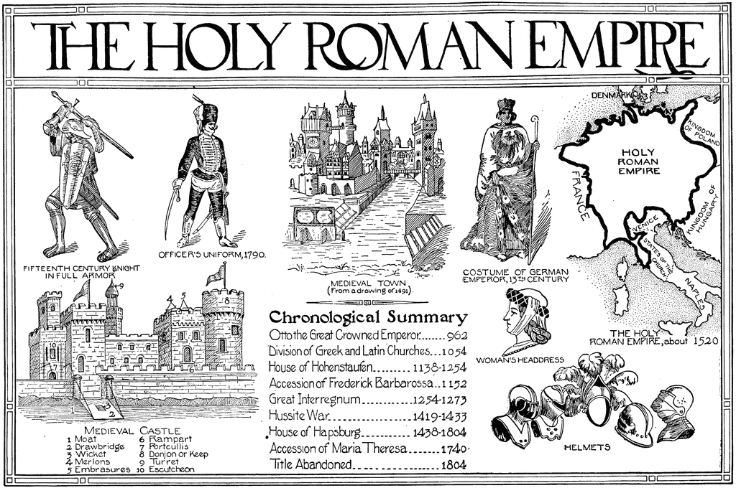
Notes:
How did the Roman Catholic Church go from being merely the first denomination ever formed after the church to a dominant world power with the authority to torture and kill any who disagreed with its doctrines? How did the papacy finally become cemented as the head of the church? How did the church and state work together when the pope yielded so much power, in some cases even greater than the emperor? Studying the formation of the Holy Roman Empire will answer these questions as well as help us to bridge the gap between the old Catholic Church and the Roman Catholic Church that existed during the times of the Reformation movement that we are rapidly approaching in our study.

Slide 3
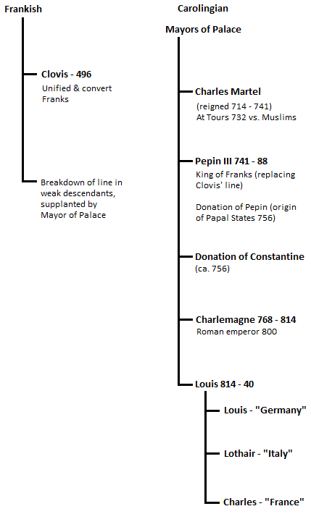
Papacy Threatened
Threats to Papacy
Emperor in Constantinople
Arian Lombards
Various plays for power
Franks to the rescue
Charles Martel prevented Muslim expansion into western Europe
Pepin III defeated Arian Lombards
“Donation of Constantine”
Charlemagne ended Lombard kingdom and saved Leo III from assassination
Notes:
The papacy found itself subject to various pressures that were threatening the increasing strong claims to power that they were making. The emperors in Constantinople believed the church should be subordinate to the state, but the popes saw this as an encroachment on their prerogatives. The Arian Lombards (those Christians who believed that Jesus was a created being) tried to conquer Rome more than once in order to impose their will and theology upon the Catholic Church. There were other rivalries to the papacy that threated the popes that had to be dealt with. The pope therefore sought a powerful ally who could come to her aid during times of need. One of the main allies they would recruit would be the Franks.
Clovis was the first leader to unify the Franks. He accepted Christianity through the influence of his wife, Clotilda, and most of the Franks followed suit out of loyalty to their king. His sons were weaklings and unfit to rule in his stead. Therefore once he died, the mayors of his household ruled in his place in what would be called the Carolingian dynasty. Charles Martel was known for preventing Muslim expansion into France. He was the first to stop them, earning the nickname “the Hammerer”.
Pepin III aided Pope Zacharias against the invasion of the Arian Lombards. Once they were defeated, he gave all of their land in central Italy to Pope Stephen II called the “Donation of Pepin” which led to the papal states held interruptedly until 1870AD. The land legally belonged to the Byzantine Empire in the East, but Pepin followed a “historical document” that was called the “Donation of Constantine”. This document chronicled supposed the healing of Constantine of leprosy by the bishop of Rome. Constantine was then supposed to have made very liberal grants of territory to the bishops and declared the bishop of Rome as having preeminence over all other bishops in the church. It then stated that that was the reason Constantine withdrew to Constantinople so as not to interfere with the imperial rights of the pope. This document has been proven to be a forgery and admitted so by the Catholic Church. However, this false document exercised a very potent influence on history.
Charlemagne then became king where he completed the defeat of the Lombards and saved Pope Leo III from ambitious rulers who had attempted to kill him so that another might sit on the papal throne. This relationship between Charlemagne and Leo III would become a precedent for the coming Holy Roman Empire.

Slide 4
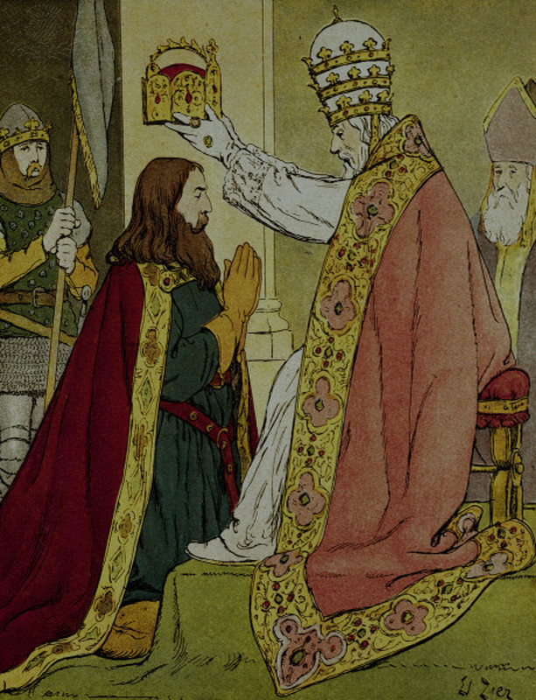
Charlemagne (742 – 814)
Leo III crowns Charlemagne
Imperialism revived
Mutual partnership
Precedent for later action
Charlemagne stood for 3 things
Law and Order
Civilization
Christianity
Notes:
On Christmas Day 800AD, Pope Leo III placed the imperial crown upon the head of Charlemagne, declaring him not just king of France (which he was already), but emperor of the Romans. The Imperial Roman Empire is now revived in the west, led by a Teuton, to replace the old Roman Empire. Charlemagne now holds the largest territory any man had held since the Fall of Rome. The kingdom of God was now thought to have had two arms: the spiritual, presided by the pope, who was responsible over men’s souls, and the temporal led by Charlemagne who was responsible for man’s physical well-being. Both the Pope and the Emperor were to give each other mutual support. When this model was copied later on in the forming of the Holy Roman Empire, it would lead to many clashes between the two offices over who exercised ultimate power over men.
Charlemagne stood for 3 things: law and order, civilization, and Christianity. He established order throughout the empire and heavily enforced the laws of the land. He created civilization by establishing schools, though the Barbarians looked down on education and culture as effeminate. However Charlemagne established a school in his own palace and set a good example by becoming a student in it. For Christianity, he began the process of liberating Spain from the Muslims and conquered the powerful Saxons in northern Germany, forcing them to accept Christianity by the tip of the sword. He also attempted to unite the eastern and western empires and even offered to marry the empress Irene, though she refused. Charlemagne was heavily influenced by Augustine’s book “City of God”, believing his empire to be God’s kingdom on Earth.

Slide 5
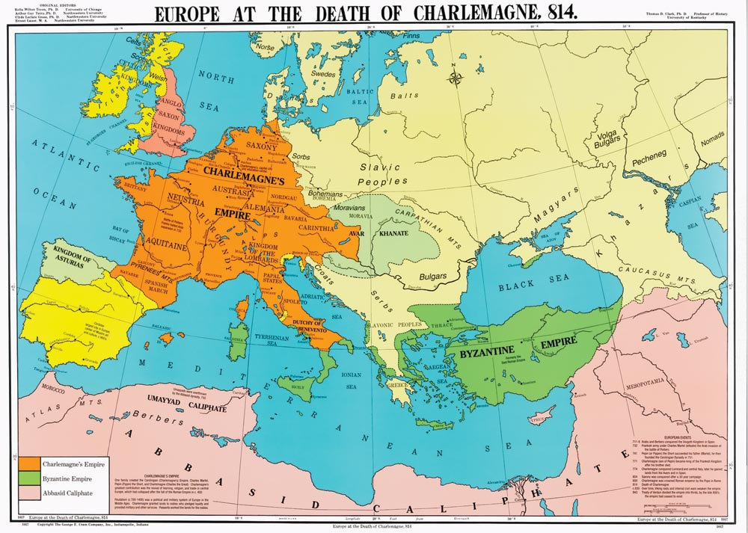
Notes:
When Charlemagne died in 814, there were 3 great empires in the known world. The oldest, though weakest, was the Eastern Empire known as the Byzantine Empire. It covered the Balkans, Asia Minor, and Southern Italy. The largest of the 3 was the Muslim Arabs. It stretched from the border of India through Persia, Syria, and Palestine in Asia, over all of Africa up to the Erbo River in Northern Spain where Charlemagne had chased them back to. The youngest and strongest was the Empire of Charlemagne, which at his death consisted of the northern half of Italy, northeast corner of Spain, all of France, Belgium, and the Netherlands as well as a large part of Germany and Austria.

Slide 6
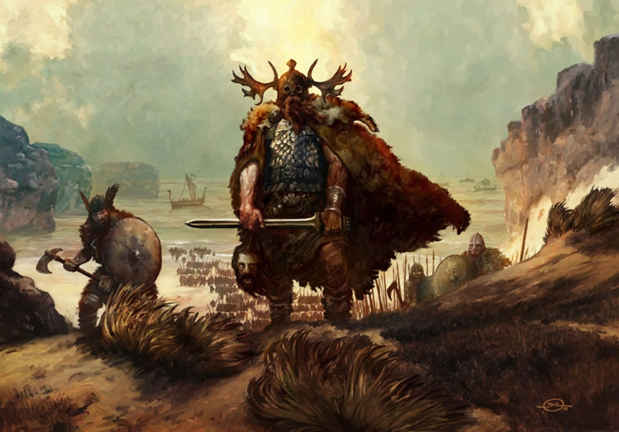
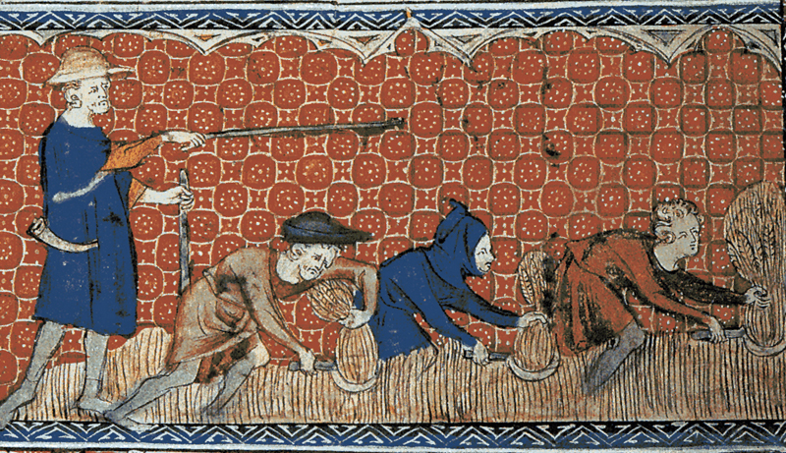
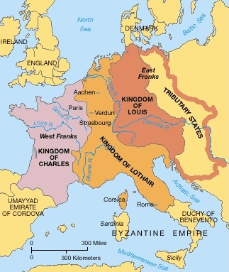
Feudalism
Causes:
Fall of Rome
End of Carolingians
Invasion by Norsemen
Notes:
Feudalism had a major influence on church history, and there were several causes for it’s occurrence:
First, the fall of Rome caused many people to have to abandon city life and go back to living off the land. How would they protect themselves? How would those who protected them provide for their needs? Feudalism became a way to seemingly provide all parties with what they needed.
Second, when Charlemagne died, neither his sons or grandsons shared his brilliance which would lead to the breaking up of the Frankish Empire. The 3 surviving sons divided the empire into 3 territories. Charles the Bald received the western territory that would become modern day France. Louis the German received the eastern portion which would become modern day Germany. Lothair was given the strip of land between the two, but this area would eventually be divided between France and Germany which confined the descendants of Lothair to modern day Italy. This led to decentralization which strengthened the rise of feudalism.
Third, invasions by Norsemen/Vikings left people defenseless and desperate for protection. Many were more than willing to offer food and other services for protection from these invaders, even if it meant enslaving themselves in the process. Those with the financial and military capability were more than willing to oblige.

Slide 7
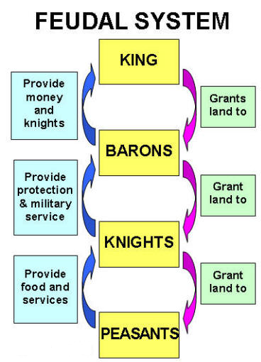
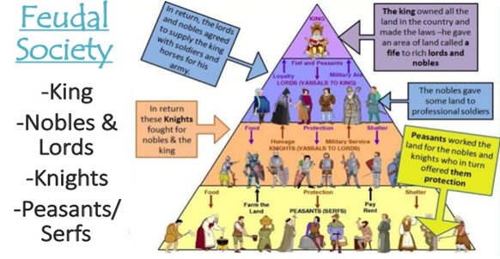
Feudalism
Influence on the Catholic Church
Secularization
Church and State
Corrupt elections
Dispute over authority
Investiture Controversy
Notes:
How did feudalism work? Charlemagne’s successors divided their land amongst their barons/nobles/lords on the condition they give him military aid when called upon. These barons/nobles/lords in turn distributed their land to their knights/vassals who in turn granted land to the peasants/serfs/villeins/slaves. The peasants in turn provided food and services to the knights who in turn provided protection and military service to the barons who in turn provided money and knights to the king.
The influence of feudalism upon the Catholic Church cannot be overstated. Large amounts land were owned by the Catholic Church due to donations from previous emperors and pious, repentant men seeking atonement from sin. These gifts of land were held by the bishops and abbots (head of monastery). The clergy, as servants of God, could not render military support to their feudal lord. They therefore had to give part of their land to knights who would render military service for them or find other ways of doing so. This led to a secularization of the Catholic Church as its attention diverted from spiritual to material things. Also, who was his allegiance to? The feudal lord or the pope? This led to a divided allegiance that hindered the Catholic Church becoming a true spiritual entity. It also placed the Catholic Church in subjection to the state in many instances.
Nobles often interfered in elections to ecclesiastical positions for a relative. Many of these men were worldly and had no interest in spiritual matters that were inherit with the position. Between 891 and 955AD, there were 20 popes because whichever noble family gained control of Italy dictated who the next pope was going to be.
The investiture controversy was the most significant conflict to ever develop in Medieval History between the church and the state. It was a dispute as to whether the feudal lord or the pope should appoint a bishop or abbot in the respective territory, and this caused hard feelings to develop between the church and state. This led to the church leaders neglecting spiritual duties as they were more concerned with controlling land than giving it over to a bishop/abbot who was merely the relative of one of the vassal lords.

Slide 8
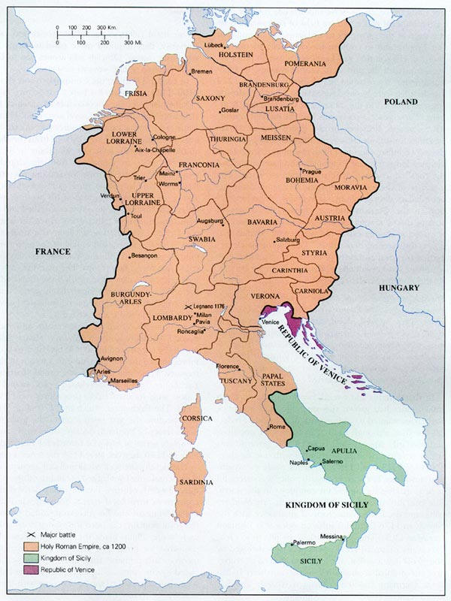
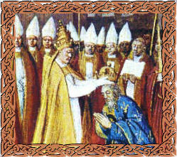
Holy Roman Empire
Reason for Formation
Unity against invaders
Extend power into Rome
Copy Charlemagne
Supervise church affairs
Notes:
When Germany became a separate state following the demise of the Carolingian Empire, the tribal dukes of Germany were faced with the need to unite against the invasion by the Northmen and Slavic invaders. They therefore selected Henry the Fowler, the duke of Saxony, as their ruler in 919AD. He was able to drive back the Northmen and Slavs. He was then succeeded by his son Otto I in 936AD. Otto made the other dukes his vassals and took over the supervision of the church in appointing bishops and abbots in Germany. When Pope John XII was being threatened in Italy, he took a play out of Charlemagne’s playbook and crossed the Alps to the south to come to his aid. The Pope then took a play out of Leo III ‘s book when he in turned crowned Otto I as emperor of the Holy Roman Empire in 962AD. This empire would last until 1806AD when it would be dissolved by Napoleon.
If Otto had kept his efforts to Germany alone, he might have built up a powerful, centralized monarchy. But he and his son and grandson would constantly meddle in the affairs of the church and cross over the Alps in the south to extend their own interests in Rome. This constant interference by the German rulers in the affairs of the papacy led to a vicious struggle between the emperor and the pope until Pope Innocent III humiliated and defeated the emperor and ended German interference in Italy.

Slide 9
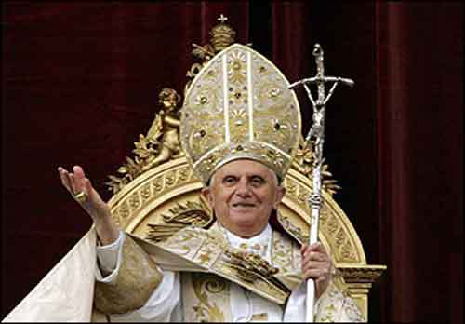
Rise of Papal Supremacy
Contributors
Barbarians came under Rome’s spell
Fall of Rome boosted papal power
Islam removed 3 patriarchal bishops
Monastic reforms
Deceit
“Donation of Constantine”
“Isidorian Decretals”
Great Schism
Notes:
There were several things that contributed to the rise of papal supremacy:
Because most missionaries came from Rome, many Barbarians were already nominal Christians before they took over Rome. Since the missionaries were biased toward the bishop of Rome, their influenced caused Barbarians to be partial toward Rome as well.
When Rome fell and deposed of its emperor Romulus Augustus, it left the Roman bishop as the one whom people looked up to. Since most barbarians were already nominal Christians, they allowed the bishop to exert his power and authority over the people. In turn, people looked up to the bishop of Rome for what to do in such turbulent times.
Before the rise of Islam, there were 5 Patriarchal Bishops who were suppose to share equal authority over the church: Rome, Constantinople, Jerusalem, Antioch, and Alexandria. When the second Islamic caliphate Umar conquered modern day Syria, Palestine, and North Africa, those respective patriarchal bishops were removed leaving only the bishop of Rome and Constantinople.
By the tenth century, monasteries had become wealthy and corrupt. The earlier ideal of service had been replaced by the easy life in a wealthy monastery. A reformation movement in Cluny of Burgundy (Eastern France) began where it was declared that the monastery there was to be free from all secular and episcopal control and to exercise self-government under the authority of the pope. Other monasteries followed suit. The abbot of Cluny started appointing the priors of new monasteries and putting them under his subjection. He worked closely with the pope in this process. This Cluniac movement added to papal power by giving the pope many zealous monks who would be his most ardent supporters.
The Donation of Constantine was a forged document that became the legal ground for the possession of land by the pope. Pepin III was the first to grant land on behalf of this document and others would follow suit. It was determined to be a forgery in the 8th century and is admitted so today by the Catholic Church itself. But by that time, the pope was in charge of much land and could use the feudal system therein to obtain more power.
The Isidorian Decretals were a collection of fictitious letters by the pseudonymous Isidore Mercator to free the Catholic Church from interference by the state and to maintain the independence of the bishops against the encroachment of archbishops attempting to extend their power. It was an attempt to push legislation through popes and kings already dead. It is entirely fictitious, however it was used to extend papal power.
While the rise of Islam removed 3 of the 5 patriarchal bishops from power in the Roman Catholic Church, the Great Schism that resulted in the split between the church in the east and west removed the patriarchal bishop of Constantinople. This by default made the patriarchal bishop of Rome the most powerful man in the Catholic Church as there was no other “spiritual” leader to oppose his claim to preeminence.

Slide 10
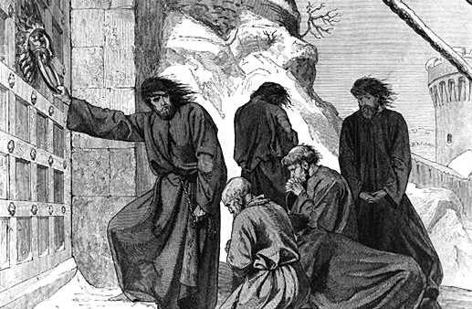
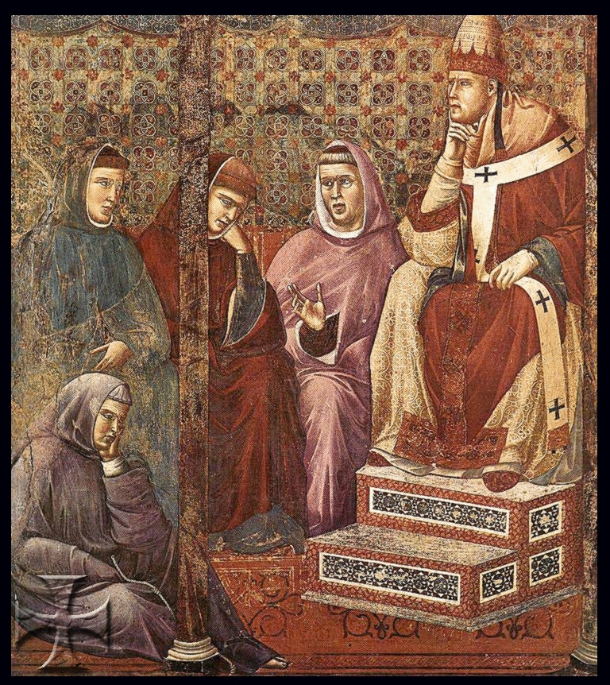
Rise of Papal Supremacy
Hildebrand (Gregory VII)
Investiture Controversy
1st to excommunicate an emperor
Inspired future popes to boldness
Innocent III
Refused King of France’s annulment
Excommunicated King of England
Replaced Holy Roman Empire’s King
Notes:
By the middle of the 11th century, the only thing that stood in the way of the pope gaining supremacy was the constant interference by the emperor of the Holy Roman Empire. The emperors had scored some decisive victories early on. In 1046, Henry III deposed 3 rival popes and then personally selected 4 or 5 over the next 10 years. However, two popes would eventually come to power who would finally be able to extinguish the emperors power: Gregory VII (Hildebrand) and Innocent III.
In 1075, Pope Gregory VII decreed that no lay ruler could make ecclesiastical appointments – this became known as the investiture controversy. Henry IV then sends a threatening letter to the pope. The pope responds by excommunicating the emperor, an extremely bold move unheard of at that time. Henry IV’s enemies declared to him that if he did not get the excommunication lifted, they would depose him as emperor. Faced with the danger of losing his throne, he traveled south over the alps to meet with Gregory at Canossa. The pope made him wait 3 days outside standing barefoot in the snow before he would admit him into his presence, at which point he lifted the excommunication. Henry would eventually be excommunicated a 2nd time, but Henry, with Germany’s support, invaded Italy and selected another pope. Gregory got help, but it backfired and he had to live the remainder of his life in exile. Though he died in exile, later popes built on the foundation he had laid.
When France and England became two of the most important emerging national states, the pope, Innocent III, began to wield his power upon the kings of those two nations. Philip Augustus, King of France, had married Ingeborg of Denmark after the death of his wife. When she arrived in France, he changed his mind about her and ordered the French bishops to annul the marriage where he then took Agnes as his wife. The pope ordered him to reverse his decision and when he refused the pope placed France under an interdict. This closed all churches, except baptism of infants and extreme unction for the dying, forbade mass, and banned burial in consecrated ground. This created such an uproar in France that Philip was forced to submit to the pope’s will. The pope also excommunicated King John of England when he rejected his selection of archbishop of Canterbury and placed an interdict on England. John was forced to humble himself to the pope and admit that all of England was a feudal vassal under the pope and agreed to pay the pope a thousand marks annually. Finally, the pope was able to humble the Holy Roman Empire by replacing Otto IV him with Frederick II and then hiring France to defeat Otto.

Slide 11
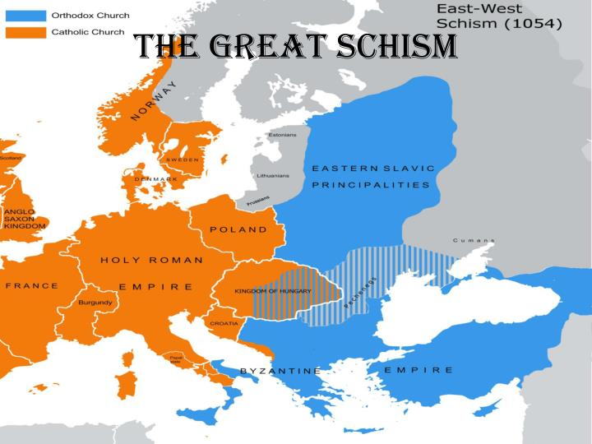
The Great Schism
Causes
Yoke of eastern emperor
Solving doctrinal issues
Celibacy
Beards
Language
Filioque Clause
Easter
Bowing before images
Type of bread in communion
Notes:
The church in the east was distracted by several things: fighting to restrain Muslim domination, the control of the emperor, and theological decline. All of these things kept the eastern empire from opposing the rise of the temporal and spiritual power of the Roman bishop. The rise in antagonism between the two sections of the church would lead to its inevitable break in 1054AD.
While the bishop of Rome had no great political rival following the fall of Rome, the church in the east was always under the eye of its emperor and thus could never gain its independence like that of the west. Therefore emperors in the east were almost like popes themselves while the popes in the west were practically emperors. This gave both sections different outlooks on temporal power.
The church in the Latin west had little difficulty formulating doctrine because it did so practically. The church in the Greek west, though, was more philosophically inclined to solve problems on a theological basis which led to more problems than that of the West. Celibacy was practiced by bishops in the west while marriage was allowed by those of the east. Clergy in the west were allowed to shave while those in the east had to wear a beard. There were also disputes over what language they should use – the west used Latin whereas the East used Greek. The Filioque clause was the addition to the Nicene Creed added by the west which stated that the Holy Spirit also proceeded from the Son, whereas the east denied this. Easter was celebrated on different days. The East forbade kneeling before pictures and images whereas the west allowed it. All of this and more built up increasing hostility between the two sections of the empire.
The straw that broke the camels back occurred in 1054 when a dispute arose over whether to use leavened or unleavened bread in the communion. The church in the East condemned the church in the West for the use of unleavened bread. Pope Leo IX excommunicated the patriarch of Constantinople who in turn excommunicated the pope in Rome. This led to the permanent split of the two bodies. The church in the east would be known as the Greek Orthodox church. However this denomination would never amount to the power that the Roman Catholic Church in the West would obtain.

